Slide 1

A
ANGULAR MOMENTUM
Prof. Shafiq
Department of Physics
Jahangirnagar University

Slide 2
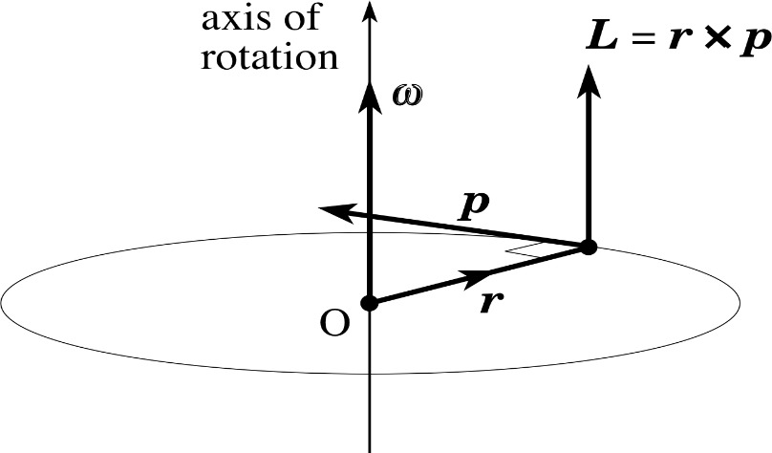

Definition
The orbital angular momentum L of a particle moving in a circular path is mathematically defined as the cross product of its position vector r from the center of the circular and linear momentum vector p, i.e. $L=r×p$. Thus,
$$\hat{x}L_{x}+\hat{y}L_{y}+\hat{z}L_{z}=\left\lfloor \begin{matrix}\hat{x} & \hat{y} & \hat{z} \\ x & y & z \\ p_{x} & p_{y} & p_{z}\end{matrix}\right\rfloor$$
$⟹$ $L_{x}=(yp_{z}−$z$p_{y})$,
${ L}_{y}=$(z$p_{x}−xp_{z}),$
${and L}_{z}$=(x$p_{y}−yp_{x}).$
$$⟹$$

Slide 3
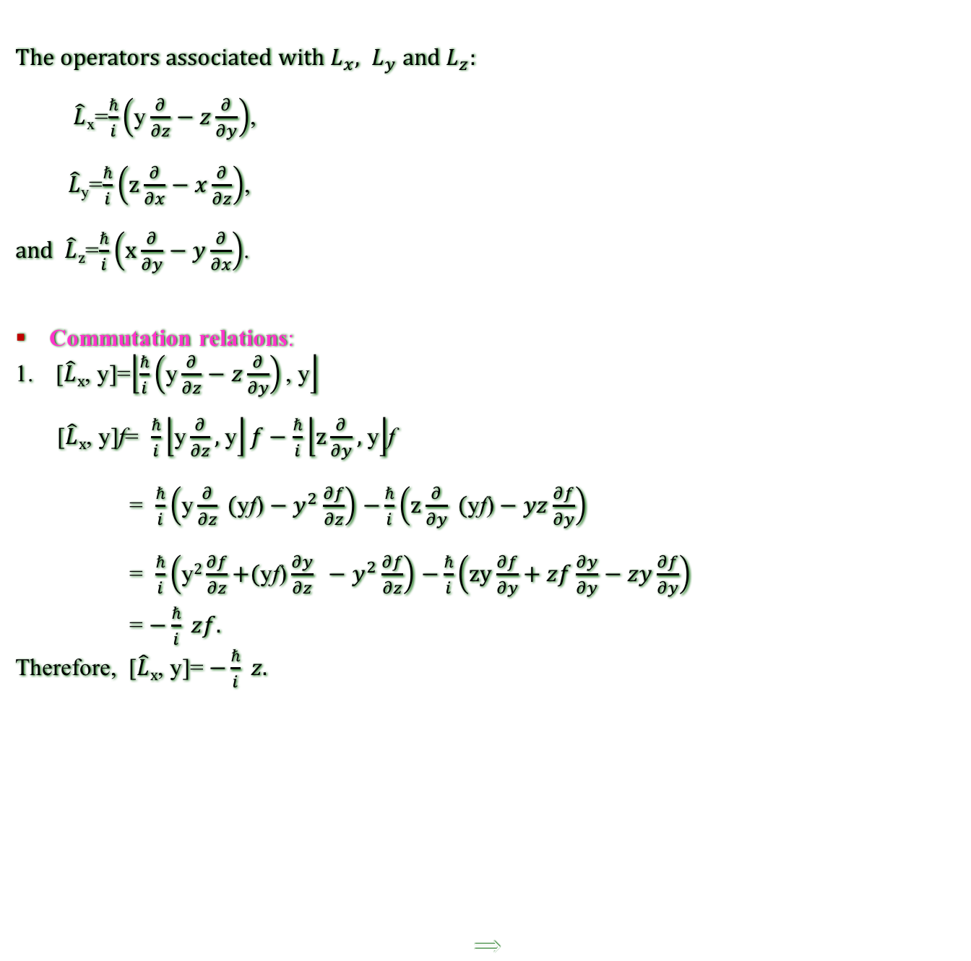

$Different compents of \hat{L}$
The operators associated with $L_{x}, L_{y} and L_{z}$:
$\hat{L}$_{x}=$\frac{ℏ}{i}\left(\text{y}\frac{∂}{∂z}−z\frac{∂}{∂y}\right)$,
$\hat{L}$_{y}=$\frac{ℏ}{i}\left(\text{z}\frac{∂}{∂x}−x\frac{∂}{∂z}\right)$,
$and \hat{L}z$=$\frac{ℏ}{i}\left(\text{x}\frac{∂}{∂y}−y\frac{∂}{∂x}\right)$.
Commutation relations:
[$\hat{L}x$, y]=$\left\lfloor \frac{ℏ}{i}\left(\text{y}\frac{∂}{∂z}−z\frac{∂}{∂y}\right)\text{, }\text{y}\right\rfloor$
[$\hat{L}x$, y]f= $\frac{ℏ}{i}\left\lfloor \text{y}\frac{∂}{∂z}\text{, }\text{y}\right\rfloor f−\frac{ℏ}{i}\left\lfloor \text{z}\frac{∂}{∂y}\text{, }\text{y}\right\rfloor$f
= $\frac{ℏ}{i}\left(\text{y}\frac{∂}{∂z} \text{(}\text{y}\text{f}\text{)}−y^{2}\frac{∂f}{∂z}\right)$ $−\frac{ℏ}{i}\left(\text{z}\frac{∂}{∂y}\text{ (}\text{y}\text{f}\text{)}−yz\frac{∂f}{∂y}\right)$
= $\frac{ℏ}{i}\left(\text{y}2\frac{∂f}{∂z}\text{+}\text{(}\text{y}\text{f}\text{)}\frac{∂y}{∂z} −y^{2}\frac{∂f}{∂z}\right)$ $−\frac{ℏ}{i}\left(\text{zy}\frac{∂f}{∂y}\text{+ }zf\frac{∂y}{∂y}−zy\frac{∂f}{∂y}\right)$
= $−\frac{ℏ}{i} zf.$
Therefore, [$\hat{L}x$, y]= $−\frac{ℏ}{i} z.$
$$⟹$$

Slide 4

Home Tasks: Show that that
[$\hat{L}x$, x]=0; [$\hat{L}x$, z]=$\frac{ℏ}{i}$ y
[$\hat{L}y$, x]= $\frac{ℏ}{i}$ z; [$\hat{L}y$, y]=$0;$[$\hat{L}y$, z]=$−\frac{ℏ}{i}$ y
[$\hat{L}z$, x]=$−\frac{ℏ}{i}y;$[$\hat{L}z$, y]= $\frac{ℏ}{i}x$; [$\hat{L}z$, z]=$0$
[$\hat{L}x$, $\hat{L}y$]=$−\frac{ℏ}{i}\hat{L}z$; [$\hat{L}y$, $\hat{L}z$]=$−\frac{ℏ}{i}\hat{ L}x$; [$\hat{L}z$,$\hat{ L}x$]=$−\frac{ℏ}{i}\hat{L}y$.
$\text{[}\hat{L}\text{2}\text{, }\hat{L}x\text{]=}\text{0; }\text{[}\hat{L}\text{2}\text{, }\hat{L}y\text{]=0; [}\hat{L}\text{2}\text{, }\hat{L}z\text{]=0;}$
$\hat{L}×\hat{L}$=$\left\lfloor \begin{matrix}\hat{x} & \hat{y} & \hat{z} \\ L_{x} & L_{y} & L_{z} \\ L_{x} & L_{y} & L_{z}\end{matrix}\right\rfloor$= $\hat{x}\left(L_{y }L_{z}−L_{z}L_{y}\right)+\hat{y}\left(L_{z}L_{x}−L_{x}L_{z}\right)+\hat{z}\left(L_{x}L_{y}−L_{y}L_{x}\right)$
= $\hat{x}\left[L_{y }, L_{z}\right]+\hat{y}\left[L_{z }, L_{x}\right]+\hat{z}\left[L_{x }, L_{y}\right]$
= $\hat{x}\left(−\frac{ℏ}{i}\hat{ L}x\right)+\hat{y}\left(−\frac{ℏ}{i}\hat{L}y\right)+\hat{z}(−\frac{ℏ}{i}\hat{L}z$)
= $−\frac{ℏ}{i}(\hat{x}L_{x}+$ $\hat{y}\hat{L}y$+$\hat{z}\hat{L}z$)
= $−\frac{ℏ}{i}$ L.
Therefore, $\hat{L}×\hat{L}$= $−\frac{ℏ}{i}$ L

Slide 5
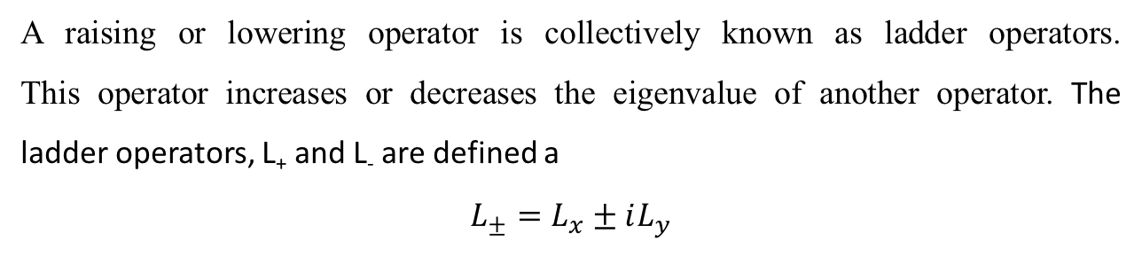
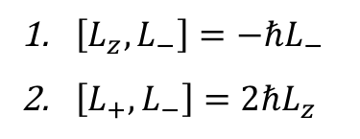
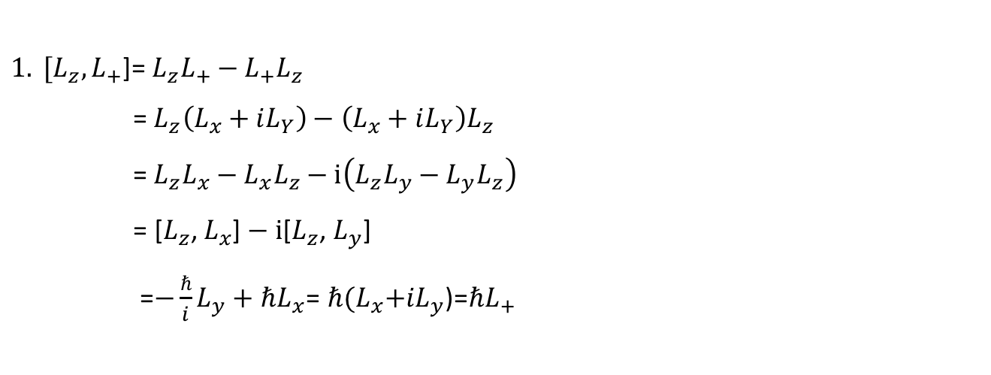
Ladder Operators:
A raising or lowering operator is collectively known as ladder operators. This operator increases or decreases the eigenvalue of another operator. The ladder operators, L₊ and L₋ are defined a
$$L_{±}=L_{x}±iL_{y}$$
${1. [L}_{z},L_{+}$]= $L_{z}L_{+}−L_{+}L_{z}$
=${ L}_{z}\left(L_{x}+iL_{Y}\right)−\left(L_{x}+iL_{Y}\right)L_{z}$
=${ L}_{z}L_{x}−L_{x}L_{z}−i\left(L_{z}L_{y}−L_{y}L_{z}\right)$
= [$L_{z}$, $L_{x}$] $− i$[$L_{z}$, $L_{y}$]
=$−\frac{ℏ}{i}L_{y}+ℏL_{x}$=$ℏ{(L}_{x}+iL_{y}$)=$ℏL_{+}$
Home Tasks: Show that
$\left[L_{z},L_{−}\right]=−{ℏL}_{−}$
$\left[L_{+},L_{−}\right]=2ℏL_{z}$

Slide 6

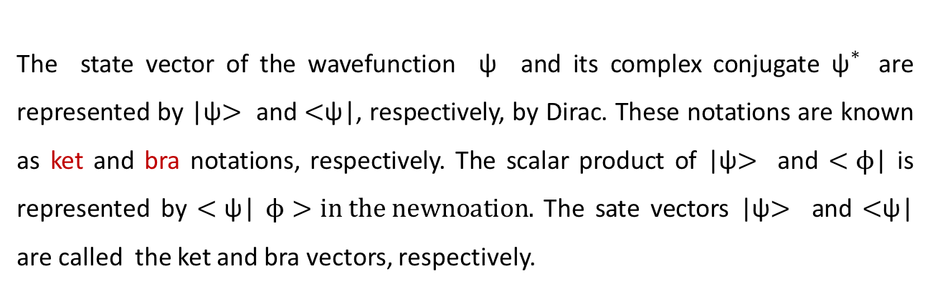
Uncertainty Principle
The uncertainty principle states that the position and the momentum cannot be correctly determined simultaneously. It is mathematically defined as $∆x∆p_{x}≥\frac{ℏ}{2},$
$$where ∆x is the uncertainty in thex component of the position and ∆p_{x}is the$$
$uncertainty in the x component of the$momentum. This is also valid for the other components of the position and the momentum, even for 3D situation.
Ket and Bra Notations
The state vector of the wavefunction ψ and its complex conjugate ${\text{ψ}}^{∗}$ are represented by |ψ$>$ and $<$ψ|, respectively, by Dirac. These notations are known as ket and bra notations, respectively. The scalar product of |ψ$>$ and $<ϕ$| is represented by $<\text{ψ}$| $ϕ>in the newnoation.$ The sate vectors |ψ$>$ and $<$ψ| are called the ket and bra vectors, respectively.

Slide 7

a-flower
Thnk you all

